Slide 1

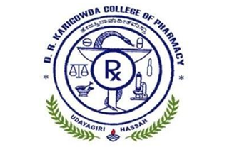
D R KARIGOWDA COLLEGE OF PHARMACY
Kuvempunagar, Hassan – 573201, Karnataka
DIETARY SUPPLEMENTS AND NUTRACEUTICALS
2023 – 2024
“THE HERBAL DETOXIFYING TEA FROM DANDELION EXTRACT”
Under the Guidene of
Mahaveer Singh
M Pharm, Associate Professor
Department of Pharmaceutics
D R Karigowda College Of Pharmacy
Presented by Usha N 20P1191

Slide 2
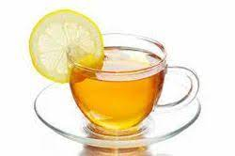
CONTENT
INTRODUCTION
AIMS AND OBJECTIVES
REVIEW OF LITERATURE
INGREDIENT PROFILE
METHODOLOGY
RESULTS AND DISCUSSION
CONCLUSION
BIBLIOGRAPHY

Slide 3
INTRODUCTION
The main purpose of this project is to develop and assess a natural, herbal-based detoxifying tea that supports the body's cleansing processes.
This tea is designed to provide a natural and effective solution to modern health concerns, aligning with the increasing demand for safe and natural wellness products.
What is herbal tea?
Not actual tea (as these beverages typically do not contain the leaves or leaf buds of tea plants)
Tisanes: Infusions of herbs, spices, fruits, and other plant materials.
What is detox tea?
Detox teas are herbal blends designed to promote digestion, cleanse the liver, and support the kidneys in flushing out toxins.

Slide 4

Dandelion is traditionally recognized as a medicinal herb and a natural cleanser for the liver and digestive system.
Its roots stimulate bile production, which is essential for liver detoxification and breaking down dietary fats.
This bile-stimulating effect improves liver health and digestion, helping with issues like bloating and indigestion.
Dandelion acts as a natural diuretic, supporting the elimination of excess fluids and toxins through the kidneys.
Rich in antioxidants like beta-carotene and polyphenols, dandelion protects liver cells from oxidative stress and inflammation.

Slide 5
Dandelion herbal detoxifying tea can be greatly enhanced by incorporating a variety of ingredients such as Neem, Turmeric, Ginger, Mint, Tulsi, Lemon, Amla, Liquorice, and Cardamom.
This tea helps,
Dandelion, Neem, Turmeric → supports liver health through bile production
Ginger, Mint → enhance digestion
Amla, Lemon → combats oxidative stress
Tulsi, Turmeric, Cardamom → boost immunity
The preparation involves careful selection, drying, grinding and formulation of ingredients into a balanced tea blend, with packaging designed to retained freshness.
Phytochemical analysis confirms the presence of active compounds, while activity tests demonstrate antioxidant, anti-inflammatory and antimicrobial properties.
Heavy metal testing ensures the safety of the product.

Slide 6
MECHANISM
Absorption
Detoxification
Kidney filtration
Elimination
Active ingredients are absorbed into the bloodstream through the digestive system.
Neutralize harmful toxins, aiding the liver in eliminating waste.
Filter the detoxified blood, removing extra water, toxins, and waste.
Diuretic properties promote increased urine, helping eliminate more toxins.

Slide 7
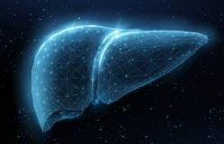
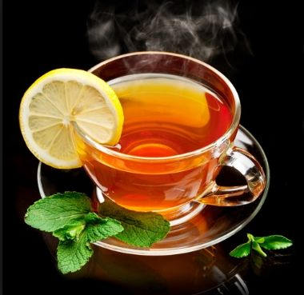

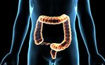



Liver detoxification
ADVANTAGES
Antioxidant support
Enhance digestion
Weight Management
Immune boosting

Slide 8






Lower blood sugar level
DISADVANTAGES
Not for Pregnant women
Allergic Reactions
Drug Reactions
Breathing problem for Infants

Slide 9
AIMS AND OBJECTIVES
AIM
To evaluate the effectiveness of dandelion tea as detoxifying agent.
OBJECTIVE
To achieve the above mention aim following objectives is set these are as follows.
Collection, authentication, identification of crude drugs for herbal detoxifying tea.
Preparation of tea and its evaluation for secondary metabolites such as alkaloids, flavonoids, tannins by qualitative phytochemical analysis.
Evaluation of tea for anti-oxidant activity, anti-microbial activity, anti-inflammatory activity and heavy metal chelation test.

Slide 10
REVIEW OF LITERATURE
The literature survey involved referring to various scientific journals, textbooks, and online resources. Relevant studies are highlighted below
Agarkar et al., (2018): Methods for identifying bioactive compounds in herbal formulations, focusing on antioxidant, anti-inflammatory, and antimicrobial properties.
Klimek-Szczykutowicz et al., (2020): Comprehensive review of dandelion, emphasizing its antioxidant and anti-inflammatory effects.
Saqib et al., (2022): Therapeutic roles of Mentha species, highlighting cardiovascular benefits and antioxidant properties.
Khan et al., (2009): Medicinal roles of Emblica officinalis with antioxidant and hepatoprotective effects.
Cohen et al., (2014): Tulsi's role in managing stress, immunity, and health promotion.
Jadav et al., (2018): Cardamom's antioxidant and antimicrobial effects with applications in food and medicine.

Slide 11
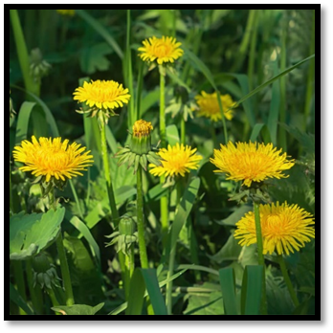
INGREDIENT PROFILE
DANDELION (Taraxacum officinale) → Astraceae
Chemical constituents:→ Phenolic acids (Chicoric acid, chlorogenic acid), sesquiterpenes
Uses:→ Detoxifying, diuretics, antioxiant, anti-inflammatory, antibacterial,

Slide 12
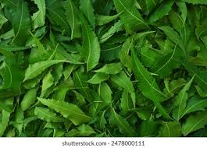
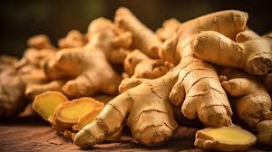
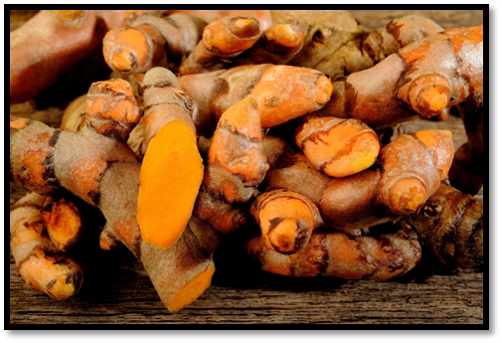
NEEM (Azadirachta indica) → Meliaceae
Chemical constituents:→ Nimbin, nimbolide, quecertic, β-sitosterol.
Uses:→ Anti-inflammatory, antibacterial, anticancer, anti-diabetic, skin care.
GINGER (Zingiber officinale) → Zingiberaceae
Chemical constituents:→ Volatile oil, terpenes, phenolic compounds
Uses:→ Anti-inflammatory, antibacterial, anticancer, anti-diabetic,
flavoring agent
TURMERIC (Curcuma longa) → Zingiberaceae
Chemical constituents:→ Curcumin (yellow phenolic pigment)
Uses:→ Antioxidant, anti-inflammatory, antibacterial, anticancer, anti-diabetic, flavoring agent

Slide 13
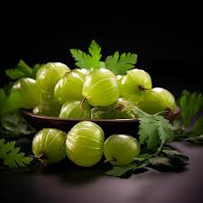
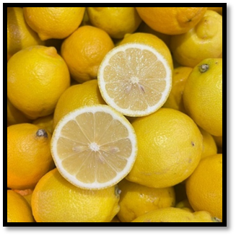
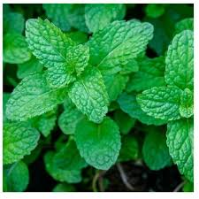
AMLA (Emblica officinalis) → Euphorbiaceae
Chemical constituents:→ Vitamin c, amino acids and phytochemicals
Uses:→ Antioxidant, antibacterial, digestive aid, immune boosting,
weight management, anti-aging.
LEMON (Citrus limon) → Rutaceae
Chemical constituents:→ Citric acid, Vitamin C, Phenolic acid, essential oils Uses:→ Antioxidant, digestive aid, immune boosting, weight management, detoxification.
MENTHA (Spearmint) → Lamiaceae
Chemical constituents:→ menthol, menthone, polyphenols, flavonoids
Uses:→ Antioxidant, anti-inflammatory, antibacterial, digestive aid,
cooling sensation

Slide 14
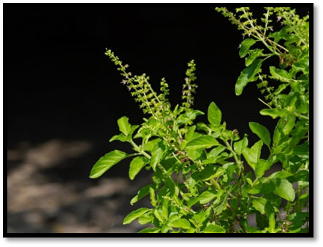
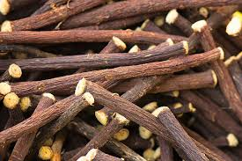
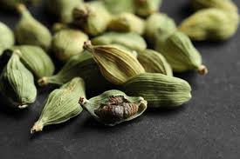
TULSI (Ocimum sanctum) → Lamiaceae
Chemical constituents:→ Eugenol, alkaloids, saponins, tannins, sesquiterpenes
Uses:→ Antioxidant, anti-inflammatory, antibacterial, antiviral, anticancer, immune stimulant, analgesic.
LICORICE (Glycyrrhiza glabra) → Leguminosae
Chemical constituents:→ Glycyrrhizin, flavonoids,
Uses:→ Flavoring agent
CARDAMOM (Elettaria Cardamomum) → Zingiberaceae
Chemical constituents:→ Terpenes, flavonoids, esters, linalool
Uses:→ Flavoring agent, gastroprotective.

Slide 15
METHODOLOGY
PREPARATION PROCESS OF HERBAL DETOXIFYING TEA
Selection and Sourcing of Ingredients
Drying
Grinding
Packaging
Storage
Brewing

Slide 16
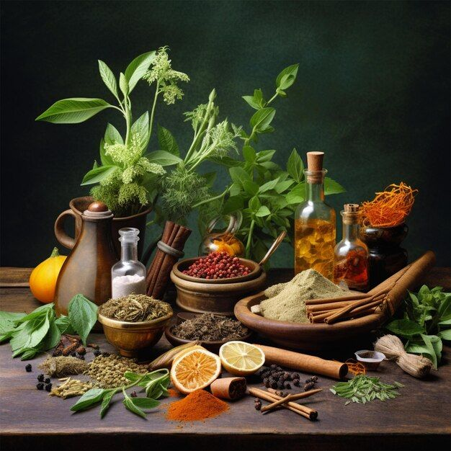
Selection
Drying
01
Ensure ingredients are organic and pesticide-free.
Use high-quality, fresh herbs for better medicinal properties.
Grinding &
Blending
02
Dehydrate herbs at 60°C for 8–12 hours until crisp.
Use clean and controlled environments for optimal results.
03
Grind ingredients separately, starting with harder roots.
Blend evenly for balanced flavor and medicinal benefits.

Slide 17
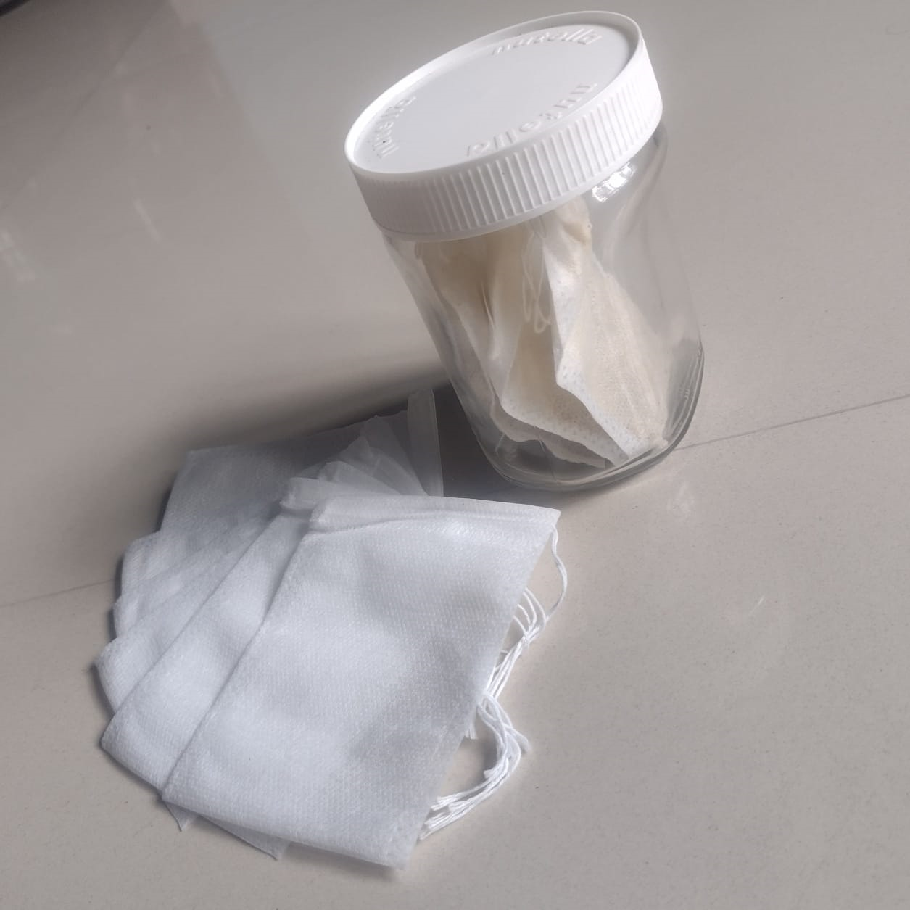
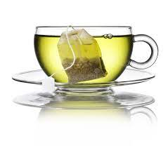
Packaging
Storage
04
Use biodegradable tea bags for sustainability.
Carefully fill and seal the bags to prevent spillage.
Brewing
05
Store in airtight containers to preserve freshness.
06
Brew 3-5 minutes for optimal flavor and health benefits.

Slide 18
FORMULA
SL NO | INGREDIENTS | F₁ | F₂ | F₃
1 | Dandelion | 0.4 g | 0.3 g | 0.3 g
2 | Neem | 0.3 g | 0.2 g | 0.2 g
3 | Turmeric | 0.4 g | 0.3 g | 0.3 g
4 | Ginger | 0.5 g | 0.6 g | 0.5 g
5 | Amla | 0.8 g | 0.3 g | 0.7 g
6 | Lemon | 0.5 g | 0.6 g | 0.5 g
7 | Mint | 0.2 g | 0.3 g | 0.4 g
8 | Tulsi | 0.4 g | 0.5 g | 0.4 g
9 | Liquorice | 0.4 g | 0.5 g | 0.3 g
10 | Cardamom | 0.1 g | 0.4 g | 0.4 g
 | TOTAL | 4 g | 4 g | 4 g

Slide 19
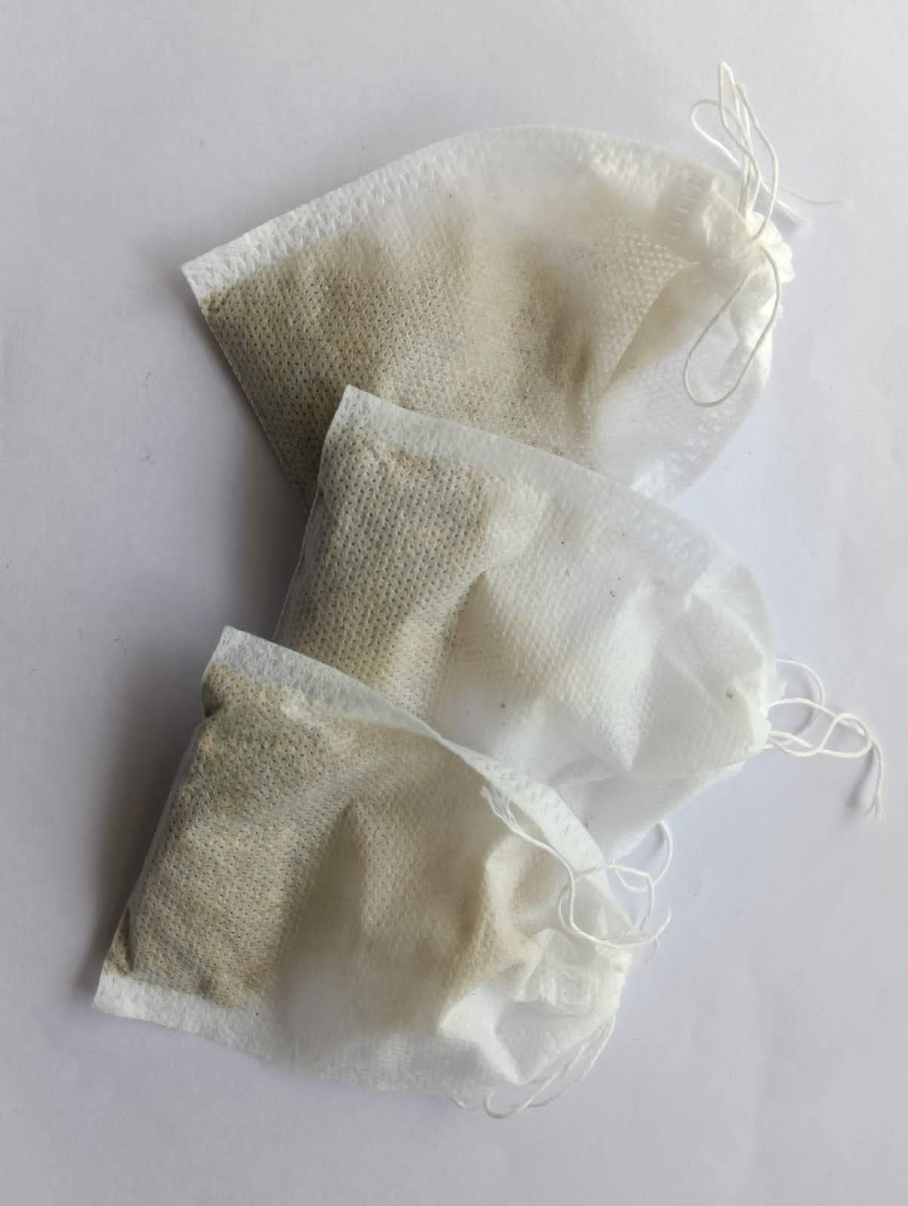
From the three formulas exhibit distinct flavor profiles-
F1 displays prominent bitterness resulting from excess Neem and Amla, potentially limiting its appeal.
F2 stands out as the most palatable option due to the careful balancing of ingredients, making it the preferred choice for consumer acceptance.
F3, while aromatic and slightly bitter, offers a unique combination that may appeal to those who favor more complex flavors.
We choosed the right formula depends on desired taste characteristics with F2 being the most suitable for general consumption.

Slide 20
MORPHOLOGICAL EVALUATION
COLOR → Greenish yellow
ODOR → Earthy aroma
TASTE → Balanced taste of earthy, bitter and sweetness
APPEARANCE → Medium coarse powder
PARTICAL SIZE → 500 – 1000 microns

Slide 21
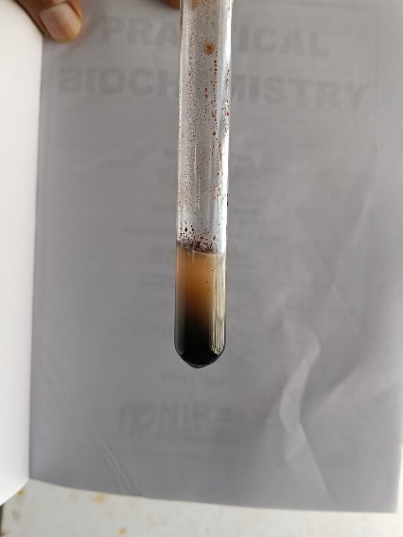
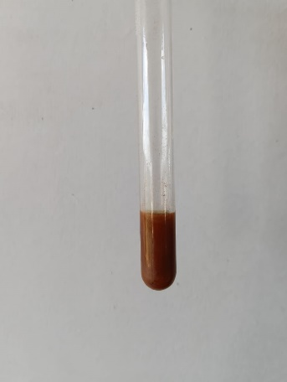
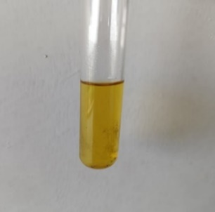
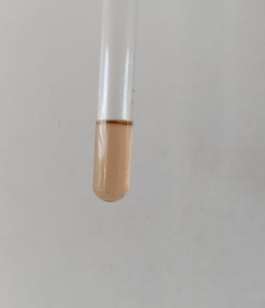
RESULTS AND DISCUSSION
QUALITATIVE PHYTOCHEMICAL ANALYSIS
Test for Carbohydrates
Molisch’s test
Sample + Molisch’s reagent
Test for Flavonoids
Alkali test
Sample + NaOH
Benedict’s test
Sample + Benedict’s reagent
Shinodas test
Sample + small piece of magnesium ribbon + conc.HCl + heat
Violet color ring at the junction of two liquids
Reddish brown ppt
Yellow color
Crimson red
Carbohydrates is present
Reducing sugars & Carbohydrates are present
Flavonoid is present
Flavonoids is present

Slide 22
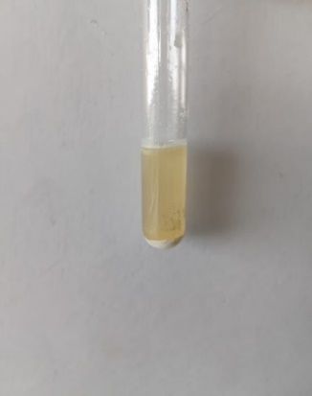
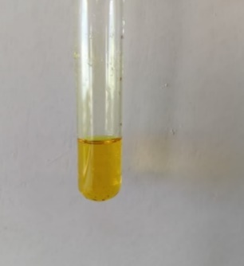
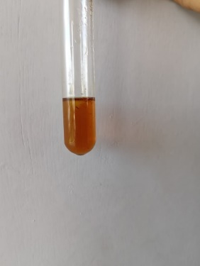
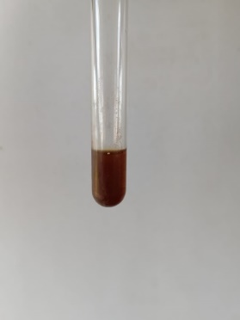
Test for Alkaloids
Mayer’s test
Sample + Mayer’s reagent
Test for Steroids and Terpenoids
Salkowski test
Sample + chloroform + conc.H₂SO₄ and shake well
Test for Proteins and Amino acids
Biuret test
Sample + 4% NaOH + few drops 1% Cu₂SO₄ solution
Hager’s test
Sample + Hager’s reagent
Cream (dull white) ppt
Yellow color
Reddish color
Voilet red
Alkaloid is present
Alkaloid is present
Steroid is present
Protien is present

Slide 23
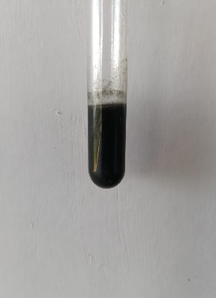
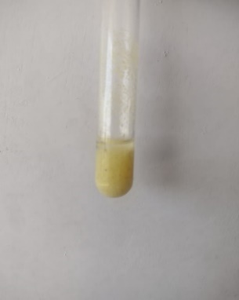
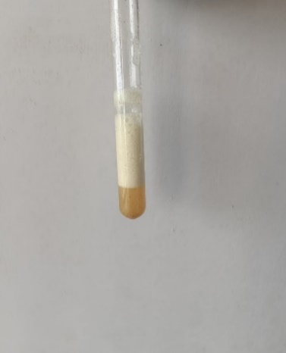
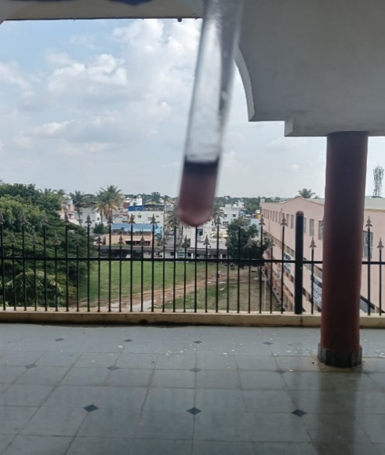
Test for tannins and Phenolic compounds
Ferric chloride test
Sample + 10% Fe₂Cl₃
Lead acetate test
Sample + lead acetate
Saponification test for liquorice
Liquorice + alkali
Sudan IV test for Mint
Sudan IV dye + extract
Blue or green color
yellow color ppt
Soap formation
A red or orange-red layer forms on the surface of the solution.
Lipids are present
Tannins and Phenolics are present
Tannin is present
Sapononin is present

Slide 24
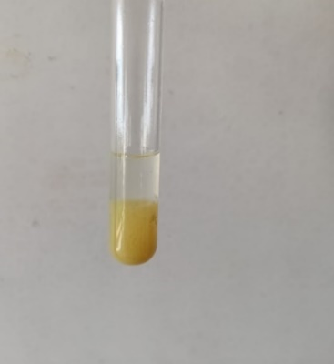
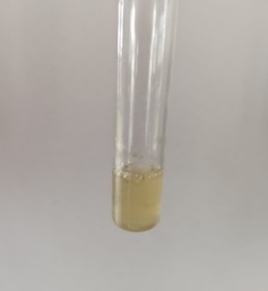
ACTIVITY TESTS
Heavy Metal Chelation Test
2ml of dandelion tea is treted with appropriate amount of lead acetate
Antioxidant Activity
Add a small amount of 3% hydrogen peroxide into 2ml of dandelion tea
Yellow ppt
Bubbling
Indicates the presence of phenolic compounds through yellow precipitate formation
Demonstrates the capability to neutralize ROS & affirming its health benefits.

Slide 25
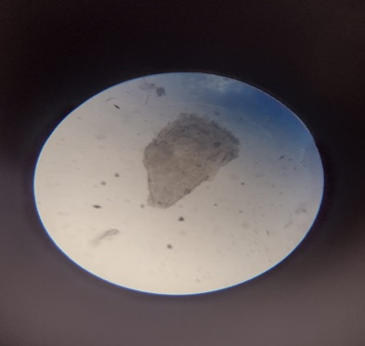
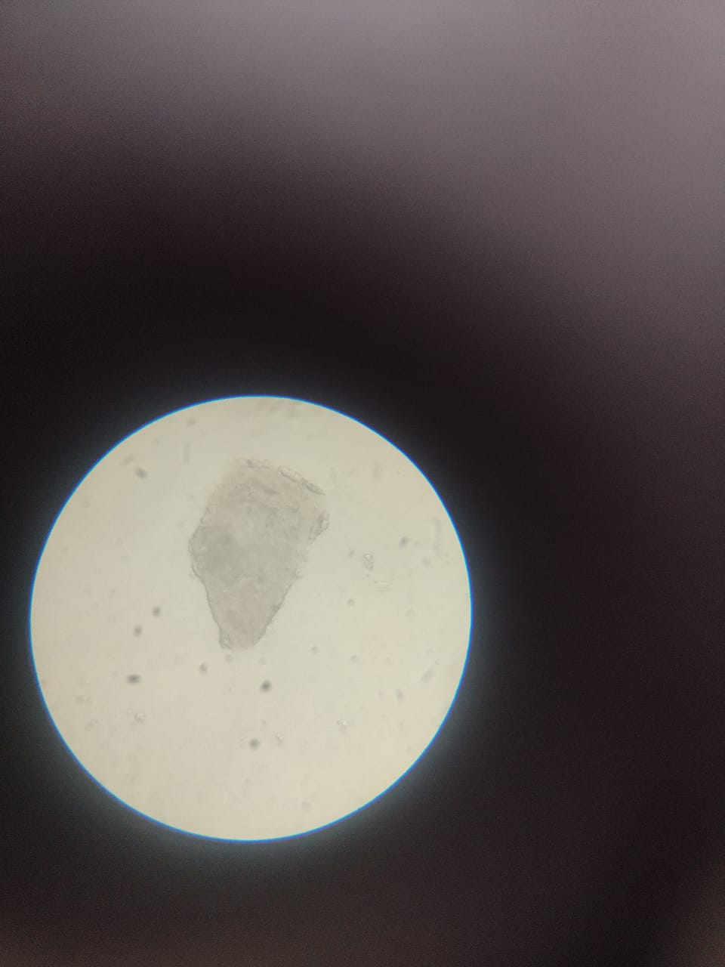
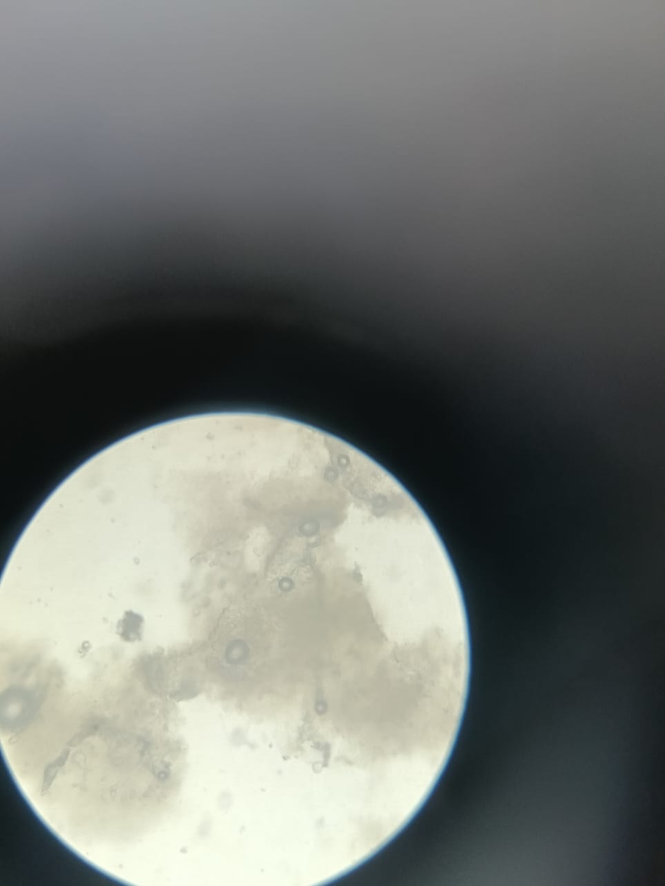
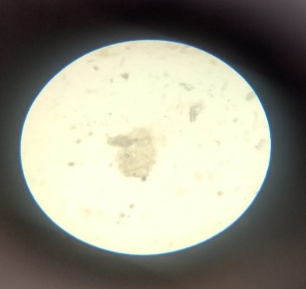
Anti-inflammatory activity
Preparation of 1% Egg Albumin Solution
1g egg albumin crystals in 100ml distilled water, shake to mix.
Egg albumin solution under microscope
Heated egg albumin solution under microscope
Egg albumin solution with sample under microscope
Heated egg albumin solution with sample under microscope
1
3
2
4
Therefore, the herbal tea stabilizes egg albumin and demonstrates anti-inflammatory potential.

Slide 26
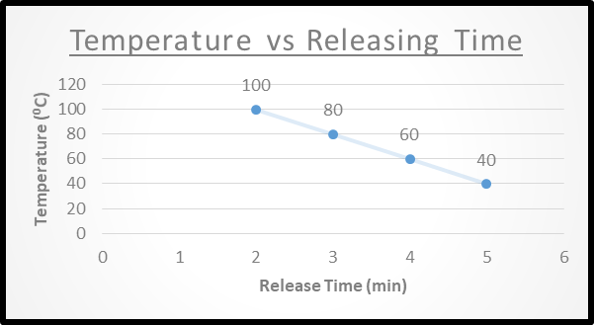
Dipping Time
Steeping Duration and Temperature:
100°C for 2 mins:
Quick dissolution, strong flavor, potential bitterness.
80°C for 3 mins:
Balanced release, smooth tea experience.
70°C for 4 mins & 60°C for 5 mins:
Milder flavor with subtle herbal notes.
Graph Analysis: Higher temperatures release active compounds faster, while lower temperatures produce gentler flavors

Slide 27
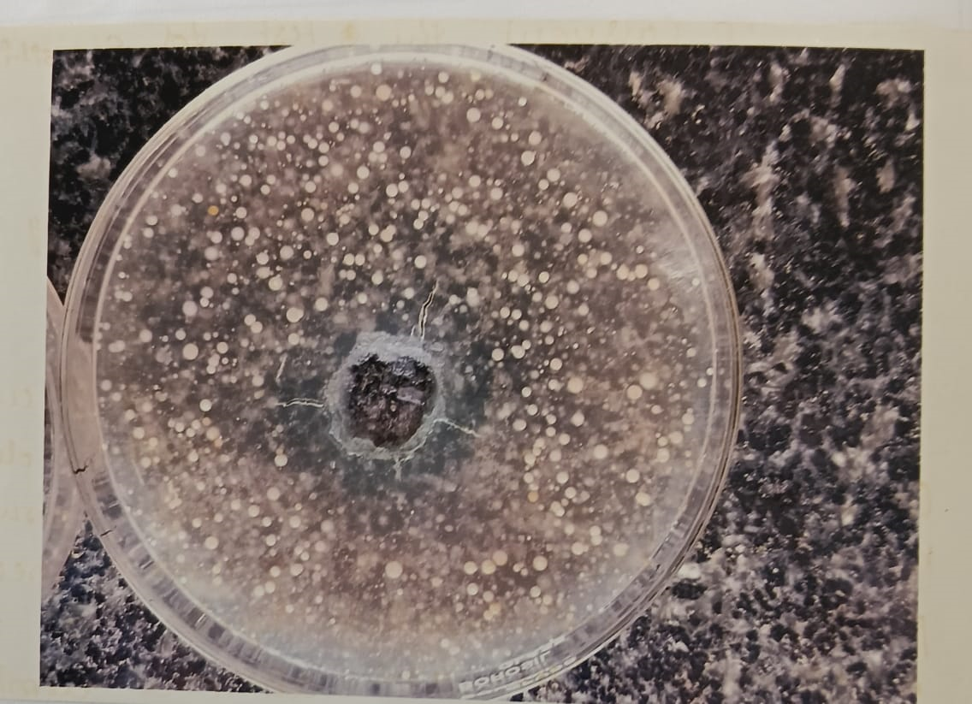
Antimicrobial Activity
Preparation
Agar plates inoculated with E. coli bacteria for uniform growth.
Ditch plate method: Prepared dandelion tea introduced into ditches in the agar and incubated at 37°C for 18-24 hours.
Observations:
Clear zone indicates antimicrobial activity.
Neem extract enhances antimicrobial properties of tea
Therefore, Neem-dandelion tea effectively inhibits E. coli growth.

Slide 28
CONCLUSION
The main purpose of this project is to develop and assess a natural, herbal-based detoxifying tea that supports the body's cleansing processes.
Dandelion is the major ingredient and dandelion tea includes other ingredients such as Neem, Turmeric, Ginger, Mint, Tulsi, Lemon, Amla, Liquorice, and Cardamom.
Dandelion tea is designed to provide specific health benefits such as detoxification, antioxidants, boost energy levels, improve immunity, release stress and enhance digestion.
The preparation involves careful selection, drying, grinding and formulation of ingredients into a balanced tea blend, with packaging designed to retained freshness.
This tea is developed through three trials (F1, F2, F3). F2 was chosen because it is more palatable and acceptable due to the higher lemon and ginger content, which enhanced the flavor.
Phytochemical analysis confirms the presence of active compounds, while activity tests demonstrate the antioxidant, anti-inflammatory and antimicrobial properties. It also assists in standardization of quality, safety and efficacy of dandelion tea.

Slide 29





From the result and conclusion of the work we can summarize that herbal detoxifying tea neutralize the harmful toxins, aiding liver in eliminating waste.
Expansion of Product Range
Exploring International Markets
Clinical Trials
FUTURE SCOPE
Sustainability Focus
Brand Collaborations

Slide 30
BIBLIORAPHY
Agarkar PH, Kulkarni JS, Maheshwari VL, Fursule RA. Practical biochemistry. 5th ed. Pune: Nirali Prakashan; 2018.
Klimek-Szczykutowicz M, Szopa A, Ekiert H. Dandelion (Taraxacum spp.)—A review of its traditional uses, phytochemistry, and pharmacological properties. Plants (Basel). 2020 Jan 17;9(1):119. doi: 10.3390/plants9010119.
Saqib S, Ullah F, Naeem M, Younas M, Ayaz A, Ali S, Zaman W. Mentha: Nutritional and health attributes to treat various ailments including cardiovascular diseases. Molecules. 2022 Oct 9;27(19):6728. doi: 10.3390/molecules27196728
Khan KH. Roles of Emblica officinalis in medicine-A review. Bot Res Int. 2009;2(4):218-28.
Cohen MM. Tulsi - Ocimum sanctum: A herb for all reasons. J Ayurveda Integr Med. 2014;5(4):251-259. doi: 10.4103/0975-9476.146554.
Jadav KD, Mehta BM. Cardamom: Chemistry, medicinal properties, applications in dairy and food industry: A review. Res Rev J Dairy Sci Technol. 2018;7(3)
Ameena M, Arumugham IM, Ramalingam K, Rajeshkumar S. Evaluation of the anti-inflammatory, antimicrobial, antioxidant, and cytotoxic effects of chitosan thiocolchicoside-lauric acid nanogel. Cureus. 2023 Sep;15(9)

Slide 31
Thank You

